Slide 1
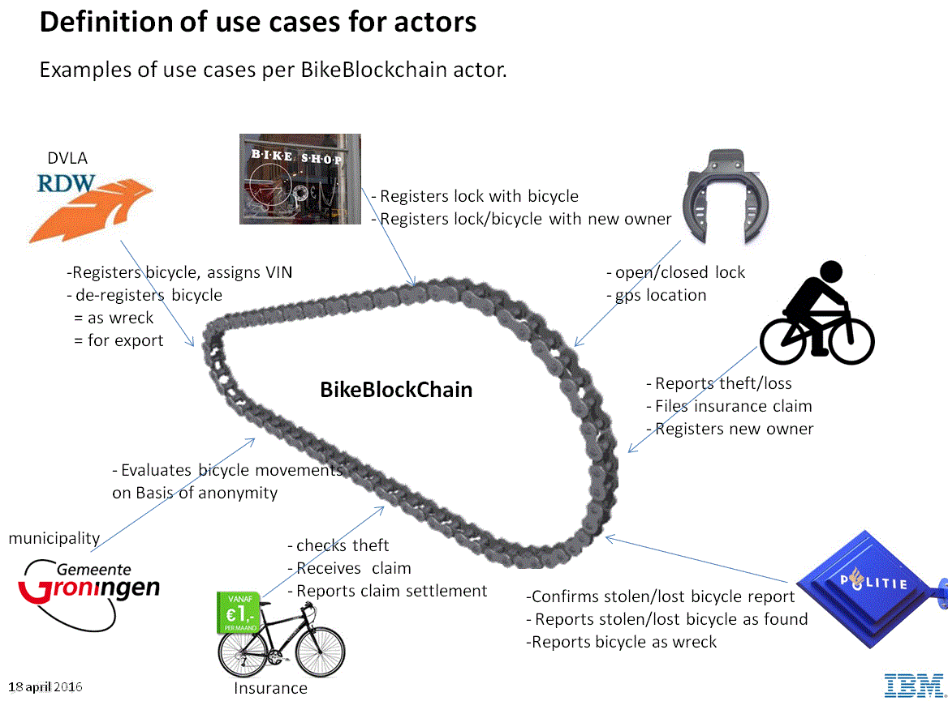
RDW BikeBlockchain Hyperledger PoC

